Slide 1


Agency Priority Goal Action Plan
Reduce the Average Length of Homelessness
Goal Leader:
John Gibbs, Acting Assistant Secretary for Community Planning and Development
Fiscal Year 2020, Quarters 1 & 2

Slide 2
Overview
Goal Statement
By September 30, 2021, reduce the average length of homelessness in communities by an average of three days from FY 2019.
Challenge
Today’s housing affordability crisis creates a more difficult environment for people experiencing homelessness to get back into housing. This is especially true in rural communities and some West Coast communities that are losing ground.¹
Rural communities face unique barriers when combating homelessness, including serving large and dispersed geographic regions.
Opportunity
HUD will support technical assistance (TA) and explore regulatory and legislative fixes to allow communities to customize their solutions to ending homelessness. HUD will use strategies learned from the 79 communities and three states that have effectively ended veteran homelessness to target Continuum of Care (CoC) and other HUD-assisted housing resources to those with the highest need.
¹ Among the 50 CoCs with the highest one-year increases in count in the 2018 Point-in-time count, 11 of those represented Balance of State CoCs, which are areas not covered by other continuums in large states and typically very rural.

Slide 3

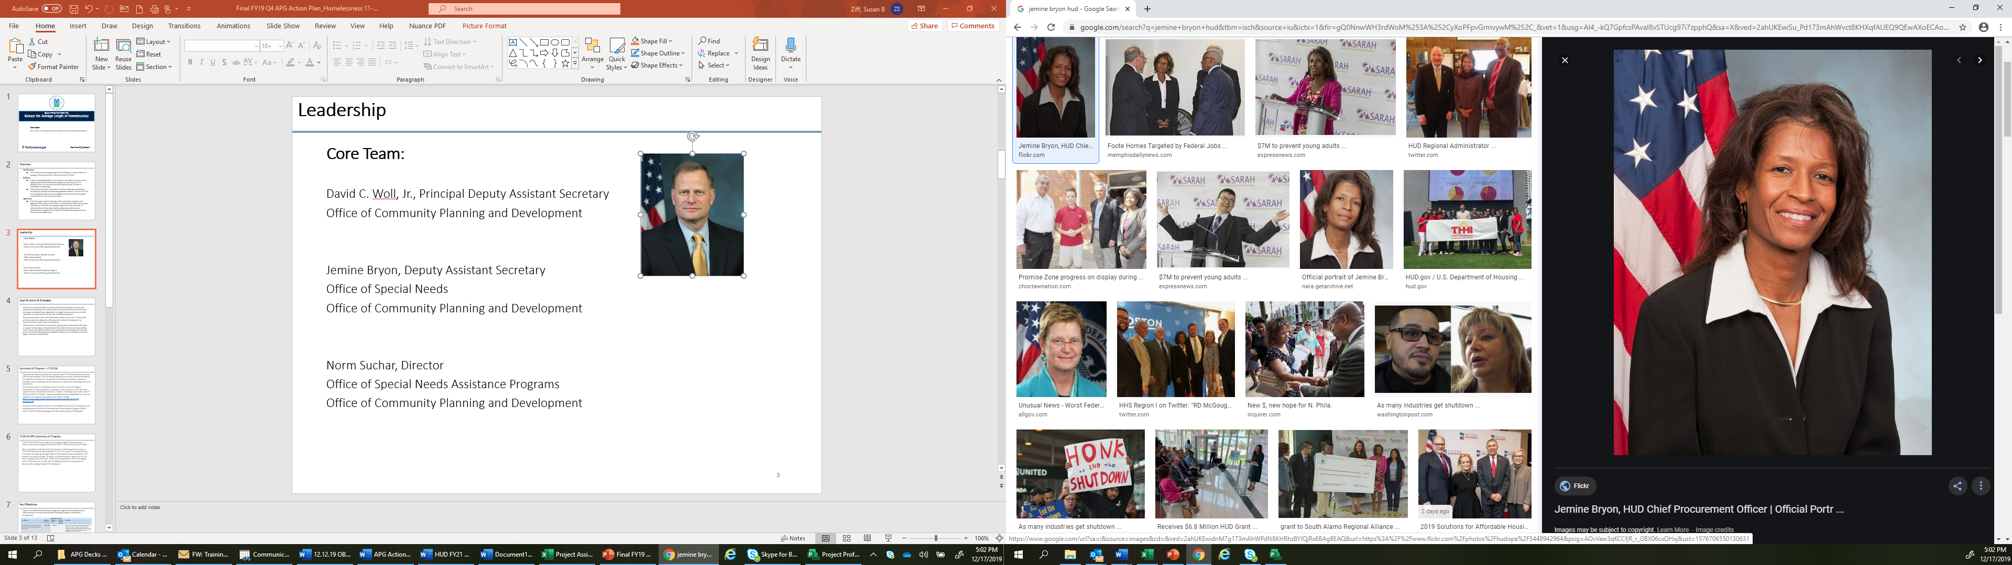
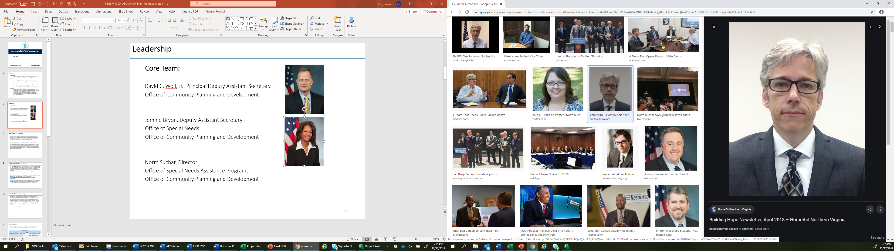
Leadership
John Gibbs
Acting Assistant Secretary
Office of Community Planning and Development
Jemine Bryon
Deputy Assistant Secretary
Office of Special Needs
Office of Community Planning and Development
Norm Suchar
Director
Office of Special Needs Assistance Programs
Office of Community Planning and Development

Slide 4
Goal Structure & Strategies
HUD aims to more quickly help Americans who become homeless to ensure such experiences are brief and non-recurring. HUD will coordinate with local communities, businesses, and philanthropic organizations to target homeless resources and other mainstream housing resources to the most vulnerable populations.
The proof exists that we can end homelessness. HUD will work with its partners to deploy the solutions that are effective, especially those producing self-sufficiency and healing from mental illness and substance abuse. HUD will also focus on assisting communities to implement “Moving on” strategies. That is, HUD will encourage communities to explore moving households with less intensive service needs to other housing options, freeing up units and service resources for persons with greater needs. HUD’s success in reducing homelessness is contingent upon effectively using and targeting resources.
HUD will push to continue this movement by applying lessons learned from the work on veteran homelessness, and best practices from local communities that are rolling out innovative, cost-effective solutions on a national scale. Knowledge will be shared across communities through several targeted TA efforts, each customized to serve the target community and population.

Slide 5
Summary of Progress – FY20 Q1
The technical assistance initiatives outlined in the FY21 Annual Performance Plan (APP) are proceeding. HUD continues to provide targeted community technical assistance to implement initiatives for households moving from permanent supportive housing to other subsidized rental assistance, as well as for unsheltered and rural populations.
HUD has been able to consolidate many functions in the CoC Program competition to reduce burdens on applicants and continues to look for more opportunities to streamline activities. A number of changes were made in the FY 2018 and 2019 CoC NOFAs. In fact, several improvements to the FY18 CoC Program Competition, where the benefits were realized in FY19, resulted in the need to process over 1,600 fewer grant agreements between the FY14 and FY18 NOFA competitions.
Over Q1, HUD was focused on conducting the annual CoC competition and finalizing the Annual Homelessness Assessment Report (published January 9, 2020).

Slide 6
Summary of Progress – FY20 Q2
In the beginning of Q2, HUD prepared for and announced the FY19 CoC Program awards. An estimated $2.2 billion in grants were announced in January 2020 and $118 million in March 2020. A total of approximately 7,000 awarded grants will allow communities nationwide to address homelessness.
In FY2020 Q2, HUD also began efforts on protecting people who are at risk of and/or experiencing homelessness from COVID-19. HUD is working closely with federal partners, especially CDC, and other national, state, and local partners to understand how best to serve the homeless amidst this pandemic and share that information with as many stakeholders as possible. HUD is also working with grantees to provide guidance, communicate best practices, and address community questions about how to safely respond to COVID-19 through:
Updated Disease Risks and Homelessness page on the HUD Exchange
Regular listservs
Weekly office hours and webinars
Guidance documents and tools
HUD is also providing direct, one-on-one TA approach targeted to communities with highest risks of COVID-19 outbreaks due to size of the homeless population. The TA strategy has been focused initially on preventing or minimizing COVID-19 outbreaks among those experiencing homelessness, but it has a long-term strategy as well to assist communities to maximize the use of stimulus funds to rehouse persons experiencing homelessness. This also includes strategic use of resources and funding to stably house those at risk of falling into homelessness.

Slide 7
Key Milestones
Create an unsheltered homelessness strategy that targets technical assistance and other resources to communities that have had large increases in unsheltered homelessness.
Milestone Summary
Key Milestone | Milestone Due Date | Milestone Status | Change from last quarter | Comments
Publish Notice for Further Comment on the Continuum of Care (CoC) Program Interim Rule. | 4/2021 | Delayed | N/A | The anticipated publication date has been pushed back from 3/31/2020 due to capacity challenges. The delay has been further impacted by HUD & communities' response to COVID-19 activities
Publish Emergency Solutions Grants Final Rule. | 4/2021 | Delayed | N/A | This due date has been pushed back from September 2020. HUD is still working to finalize the ESG Final Rule and anticipates publication in CY20. The delay has been further impacted by HUD & communities' response to COVID-19 activities
Based on analysis of data on those experiencing unsheltered homelessness, publish a policy brief that will help communities understand the challenges of the population and identify solutions to address their needs. | 12/31/2019 | Completed | N/A | HUD collaborated with the US Interagency Council on Homelessness (USICH), the National Alliance to End Homelessness (NAEH), and the California Policy Lab on this policy brief, published on 10/6/19: https://www.capolicylab.org/health-conditions-among-unsheltered-adults-in-the-u-s/
Prioritize efforts to address unsheltered homelessness and encourage communities to combine health care and housing services targeted to serve people experiencing unsheltered homelessness. | 2/28/2020 | Modified | N/A | We are currently accomplishing this milestone through implemented activities and strategies to prepare, prevent, and respond to COVID-19. Targeted technical assistance is being provided that combines healthcare and housing services for those experiencing unsheltered homelessness.

Slide 8
Key Milestones
Implement cost-effective strategies across Continuums of Care (CoCs) and other HUD-assisted housing resources that target resources to those with the highest need.
Milestone Summary
Key Milestone | Milestone Due Date | Milestone Status | Change from last quarter | Comments
Publish case studies and best practices from targeted TA communities. | 9/30/2020 | On Track | N/A | Case studies and best practices will be published as they are completed.
Enhance the Stella visualization tool to empower communities to visualize their data and conduct modeling exercises to improve the efficiency of their local resources.² | 12/31/2020 | On Track | N/A
Publish the Stella visualization resources at the CoC level for the public to review and access the performance of communities. | 12/31/2020 | On Track | N/A
² For more information on the Stella data visualization tool, see: https://www.hudexchange.info/news/snaps-in-focus-stella-a-new-way-to-see-how-your-coc-is-performing/.

Slide 9
Key Milestones
Build capacity in rural communities to coordinate services and increase access for persons experiencing homelessness.
Milestone Summary
Key Milestone | Milestone Due Date | Milestone Status | Change from last quarter | Comments
For the FY20 CoC Program application, assess questions to ensure that they take into account rural circumstances. | 12/31/2019 | Complete | N/A | HUD is currently assessing options for the FY20 CoC application cycle in light of COVID-19 activities.
Publish promising practices for serving youth experiencing homelessness in rural communities based on lessons learned from communities awarded Youth Homelessness Demonstration Program funds. | 12/31/2020 | On Track | N/A
Release new resources that identify promising practices for creating affordable housing in rural communities. | 12/31/2020 | On Track | N/A

Slide 10
Key Milestones
Increase leasing of HUD-Department of Veterans Affairs Supportive Housing (HUD-VASH) vouchers in areas with low utilization.
Milestone Summary
Key Milestone | Milestone Due Date | Milestone Status | Change from last quarter | Comments
Update HUD Field Office Monitoring Protocol document for Public Housing Agencies (PHAs) with low utilization as a part of increasing monitoring and technical assistance efforts. | 3/1/2020 | Complete | Yes | The updated HCV Optimization Protocol specifically references “Actions and Deliverables” pertaining to the monitoring of HUD-VASH.
Highlight the option of HUD-VASH Continuum,³ as well as the lessons learned and challenges, at industry conferences and outreach through federal and local partners. | 9/1/2020 | On Track | N/A
Issue additional guidance to promote the use of project-based conversions of existing HUD-VASH vouchers, especially in high-cost, low-vacancy areas. | 9/30/2020 | On Track | N/A
³ HUD-VASH Continuum is a flexibility under the existing HUD-VASH statute that gives the VA the ability to designate a CoC service provider to act on behalf of the VA, which enables them to serve VA-ineligible veterans.

Slide 11
Key Indicator – Average Length of Homelessness
This measure tracks the national average length of homelessness in CoCs. This represents the weighted average across approximately 400 CoCs for all projects within their community.
5
6
4
FY 2016 Los Angeles data was adjusted, affecting the national average by one day. This resulted in a new figure of 151 for FY2016.
5
In FY17, HUD excluded the system performance measures data from Los Angeles due to known data quality errors resulting from a change in HMIS vendor. Los Angeles resubmitted data for FY17 in FY18 and HUD has revised the national number to include this new data.
6
FY19 data will be available in August 2020.

Slide 12
Data Accuracy and Reliability
Length of homelessness Description: Average length of time persons experience homelessness. At this time, only persons experiencing sheltered homelessness are included in this measure; future data submissions will include persons experiencing unsheltered homelessness as well. Data source: Data collected in each Continuum of Care’s (CoC’s) Homeless Management Information System (HMIS). Data is reported as “System Performance Measures” into the Homelessness Data Exchange (HDX). Calculation method: Each CoC is required to collect data and report to HUD annually on specific system performance measures. These measures are based on a set of programming specifications HUD provided to communities to ensure consistency: https://www.hudexchange.info/resource/4483/system-performance-measures-tools. Data quality (limitations/advantages of the data): Data is relatively comprehensive as CoCs must report data regardless of funding source. The data is limited by how many projects report their data in HMIS and how accurate their data quality is. HUD requires each CoC to track null and missing value information as well as other data quality concerns. The rates of data quality issues per each response element that impacts the system performance measures is submitted to HUD at the time that the measures are submitted. HUD reviews this and includes the data quality piece in its larger evaluation of the system performance measures. Validation, verification, and improvement of measure: HUD includes the System Performance Measures in its annual CoC Program Competition, along with data quality and HMIS bed coverage information. This creates incentives to have accurate data as well as to show improved outcomes. Because this process is relatively new (only 2 reporting cycles to date with system performance measures), HUD knows there are data quality concerns, both with the data entered into HMIS as well as with the reporting features of the CoCs’ HMIS. HUD will continue to include this as a scoring factor and will incorporate it into more reporting requirements. HUD will provide more resources to improve data quality. HUD provided programming specifications to ensure consistency and will provide more resources to help CoCs test the accuracy of their systems to pull the data..

Slide 13
Additional Information
Contributing Programs
Organizations:
HUD Office of Special Needs Assistance Programs
HUD Office of Public and Indian Housing
HUD Office of Multifamily Housing Programs
US Interagency Council on Homelessness
US Department of Veteran Affairs
HUD Program Activities:
Continuum of Care Program
Emergency Solutions Grants Program
HUD-VA Supportive Housing Program
Public Housing
Housing Choice Vouchers
Multifamily Housing Programs
Stakeholder / Congressional Consultations
HUD works closely with local communities through the CoC Program to support tailored programs that best meet a community’s needs.

